Slide 1
Creative Taxonomy Creation
02 January 2026

Slide 2
Creative Taxonomy Creation
Walkthrough to your asset taxonomy
02 January 2026

Slide 3
Better measurement processes starts with high data quality
SECTION ▸ BIG STATEMENT

Slide 4
A structured creative taxonomy allows us to:
  Enhance classification
  Unified Connectivity
  Universal reporting
Better organize and classify your created assets with all necessary granularity, simplifying setup routines.
Standardizing taxonomy ensures end-to-end asset tracking, allowing seamless data integration across stages.
Standardization leads to homogenized deliveries across campaigns, opening multiple analysis opportunities.

Slide 5
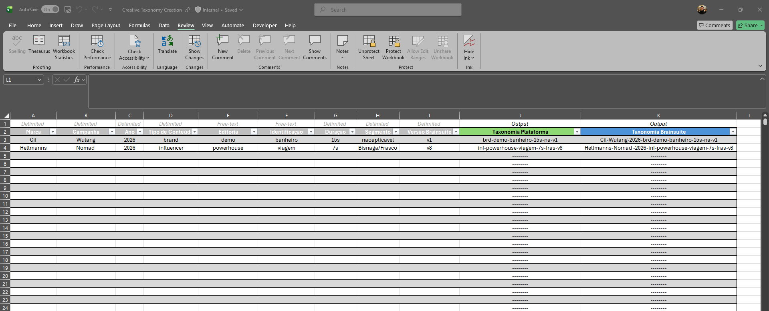

Step by step creation
SECTION ▸ TITLE ONLY
3
  Taxonomy is ready
1
2
  Access the taxonomy tool
  Fill-out required fields
Now you can copy the creative name from the respective column and start implementing throughout the platforms, such as CreativeX, Brainsuite, Microsoft App asset upload tool and local management. Please notice that Ad Platform and CreativeX have different taxonomies.
Access the creative taxonomy spreadsheet. Each agency has an unique sheet which will be provided upon request. Please check slide 10 if authorization is required.
The final taxonomy will only be generated when all fields are correctly filled out. Copying and dragging is allowed, making it easier to do bulk changes and creation. Be careful not to change previous rows.
3.1 Platform
3.2 Brainsuite
Shortened taxonomy to fit ad buying platform requirements.
Full taxonomy to enable database matches.

Slide 6
Required Info Description
Brand Name The name of the brand that you are creating the assets for. Available from dropdown menu.
Origin Classifies if the asset was created locally or if it is from global source or adaptation. Available from dropdown menu.
Identification This is also a free-text field, being the one where you can individually identify each of your assets. Here you can describe test-specifics and influencer names, for example.
Segment Specific segment of the product or product range that is being displayed in the creative asset. Please follow global guidelines on this selection. Available from dropdown menu.
Campaign Name This is the same name created at the Global Campaign Manager. Also available from dropdown field.
Content Type ‘Brand’ or ‘Influencer’, describing if the asset previews an influencer or not. Available from dropdown.
Duration How long your creative asset is. This field takes both static and dynamic (video) assets, all available from dropdown menu.
Brainsuite Version Identification of the version that will be ran in Brainsuite. Available from dropdown menu.
Year Select the main year that this asset is going to be run. Available with dropdown.
Editorial Here you can identify the creative context of your asset, such as an editorial or creative line. This is a free-text field, allowing you to create your own categories.
Creative Type Creative team to tag if the asset is completely original or if had any substantial use of AI during development. Available from dropdown menu.

Slide 7
Required Info Description
Brand Name The name of the brand that you are creating the assets for. Available from dropdown menu.
Origin Classifies if the asset was created locally or if it is from global source or adaptation. Available from dropdown menu.
Identification This is also a free-text field, being the one where you can individually identify each of your assets. Here you can describe test-specifics and influencer names, for example.
Segment Specific segment of the product or product range that is being displayed in the creative asset. Please follow global guidelines on this selection. Available from dropdown menu.
Campaign Name This is the same name created at the Global Campaign Manager. Also available from dropdown field.
Content Type ‘Brand’ or ‘Influencer’, describing if the asset previews an influencer or not. Available from dropdown.
Duration How long your creative asset is. This field takes both static and dynamic (video) assets, all available from dropdown menu.
Brainsuite Version Identification of the version that will be ran in Brainsuite. Available from dropdown menu.
Year Select the main year that this asset is going to be run. Available with dropdown.
Editorial Here you can identify the creative context of your asset, such as an editorial or creative line. This is a free-text field, allowing you to create your own categories.
Creative Type Creative team to tag if the asset is completely original or if had any substantial use of AI during development. Available from dropdown menu.
We don't always run the latest version tested in BS—if an adjustment leads to a lower score, we may opt for a previous, higher-performing version.

Slide 8
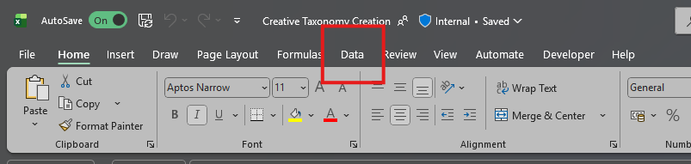
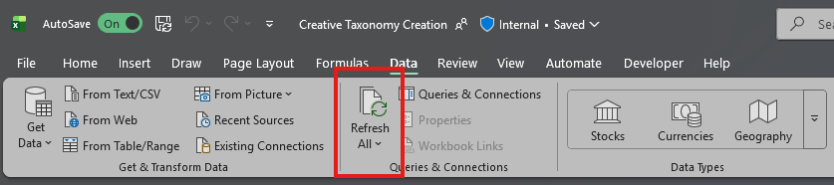
Updating Dropdowns
Please follow the instructions below if Brand, Campaign or Segment fields are outdated/have missing attributes.
1
  Go to ‘Data’ tab.
2
  Click ‘Refresh All’ button.
3
  You are good to go!

Slide 9
Taxonomy Examples

Slide 10
Ways of Working
Retest the
reworked asset
(if rework needed)
Approval/
Next Steps
Initial Briefing
Brainsuite pre‑test
PM Meeting
1
2
3
4
5
6
7
8
Script Approval
Asset Rework
(if needed)
Submission to the Marketing Team
Media Control Sheet Registration
Taxonomy
Agency
responsibility
Unilever
responsibility

Slide 11

Requesting Access
Click to access the access request form.
Your submition will be reviewed and access will be setup. This might take up to 2 business days.
Please notice that you will be requested to accept terms and conditions on first access.

Slide 12
Thank you!
Alexandre Parma – Measurement Coordinator
Julia Travaglini – CMI coordinator

